Slide 1

IT5002
Computer Systems and Applications
Introduction
colintan@nus.edu.sg

Slide 2
Q & A
Please ask questions at https://sets.netlify.app/module/6783ad89fc362746fec52180
OR scan this QR code (may be obscured on some slides)

Slide 3
Lecture 1: Introduction
Programming Languages
Abstraction
What is a Computer?
IT5002: It’s About Computer Organization and Applications
What’s Next?
Credit for course notes: A/P Aaron Tan (CS2100)

Slide 4
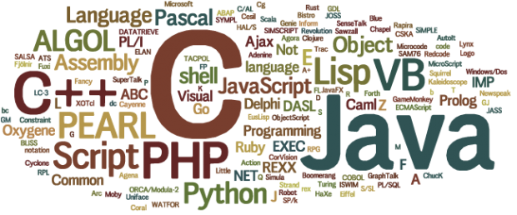
Programming Languages
Programming language: a formal language that specifies a set of instructions for a computer to implement specific algorithms to solve problems.

Slide 5
Programming Languages
High-level program
Eg: C, Java, Python, ECMAScript
int i, a = 0;
for (i=1; i<=10; i++) {
a = a + i*i;
}
a = 0
for i in range(1,11):
a = a + i*i
addi $t1, $zero, 10
add $t1, $t1, $t1
addi $t2, $zero, 10
Loop: addi $t2, $t2, 10
addi $t1, $t1, -1
beq $t1, $zero, Loop
Low-level program
Eg: MIPS (IT5002)
Machine code
00100000000010010000000000001010
00000001001010010100100000100000
. . .
Computers can execute only machine code directly.

Slide 6
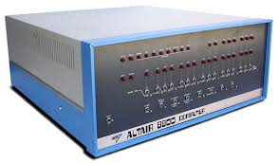
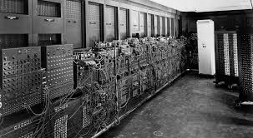
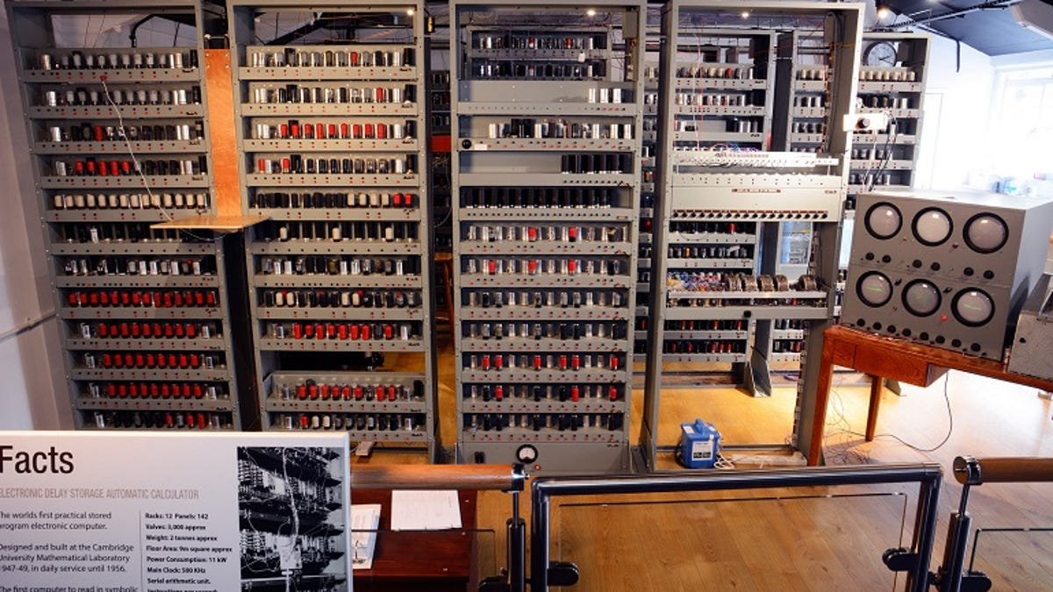
Programming Languages

Slide 7
Programming Languages
1st Generation Languages
2nd Generation Languages
3rd Generation Languages
4th Generation Languages
5th Generation Languages
Machine language.
Directly executable by machine.
Machine dependent.
Efficient code but difficult to write.
Assembly language.
Need to be translated (assembled) into machine code for execution.
Efficient code, easier to write than machine code.
Closer to English.
Need to be translated (compiled or interpreted) into machine code for execution.
Eg: FORTRAN, COBOL, C, BASIC
Require fewer instructions than 3GL.
Used with databases (query languages, report generators, forms designers)
Eg: SQL, PostScript, Mathematica
Used mainly in A.I. research.
Declarative languages
Functional languages (eg: Lisp, Scheme, SML)
Logic programming (eg: Prolog)

Slide 8
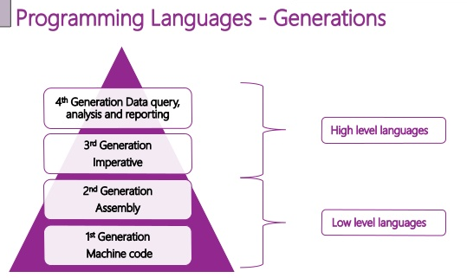
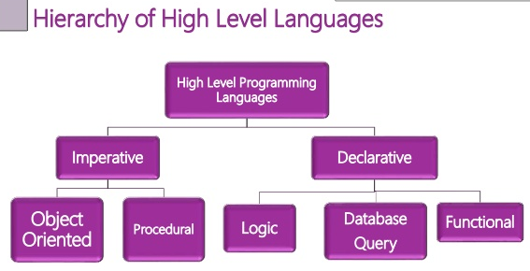
Programming Languages
“Generational” classification of high level languages (3GL and later) was never fully precise.
A different classification is based on paradigm.

Slide 9
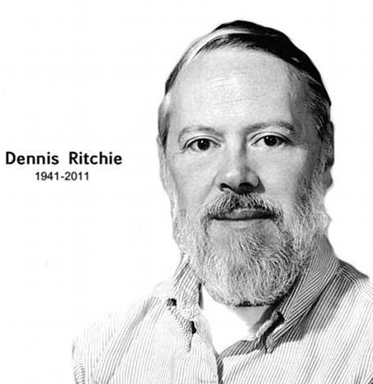
The C Programming Language
Created by Dennis Ritchie (1941 – 2011) at Bell Laboratories in the early 1970s.
C is an imperative procedural language.
C provides constructs that map efficiently to typical machine instructions.
C is a high-level language very close to the machine level, hence sometimes it is called “mid-level”.
UNIX is written in C.
HelloWorld.c
#include <stdio.h>
int main(void) {
printf("Hello, world\n");
return 0;
}
HelloWorld.py
print("Hello, world")

Slide 10
The C Programming Language
Creating a C program
  We assume that you are familiar with C Programming.
  If not see the “A Quick Introduction to C” document.
Editor
Source code
Compiler
Object code
Other object codes
Function libraries
Linker
Executable code

Slide 11
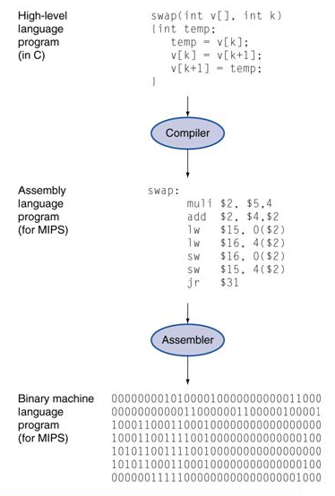
Abstraction
High-level language
  Level of abstraction closer to problem domain
  Provides productivity and portability
Assembly language
  Textual and symbolic representation of instructions
Machine code (object code or binary)
  Binary bits of instructions and data

Slide 12
Abstraction
Hardware/Software Stack in Computer
CS4212
Application software
IT5002 Part 2
Compiler
Software
Assembler
Operating System
Linker
Loader
Scheduler
Device Drivers
Instruction Set Architecture (ISA)
Processor
Memory
I/O System
Datapath & Control Design
Hardware
Digital Logic Design
IT5002 Part 1
Circuit Design
Transistors

Slide 13
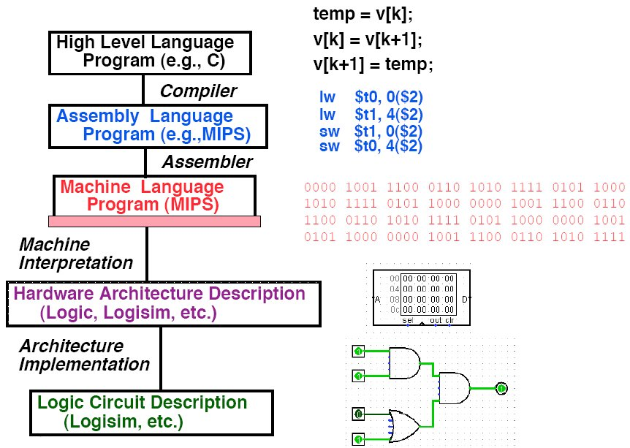
Abstraction
Level of Representation

Slide 14

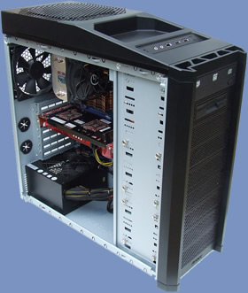
What is a Computer?
Power supply
Motherboard
Central Processing Unit (CPU)
Random Access Memory (RAM)
Hard drive
Cooling fan
I/O devices
Credit: http://www.overclock3d.net/reviews/cpu_mainboard/the_computer_council_-_clocked_gamer_quad/1
Credit: http://tech3news.com/most-recent-computer-technology/

Slide 15
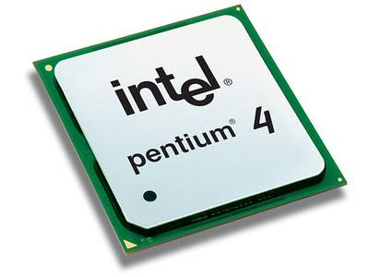
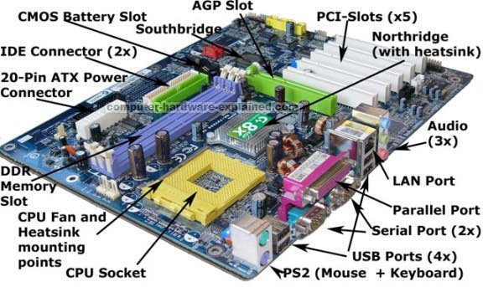
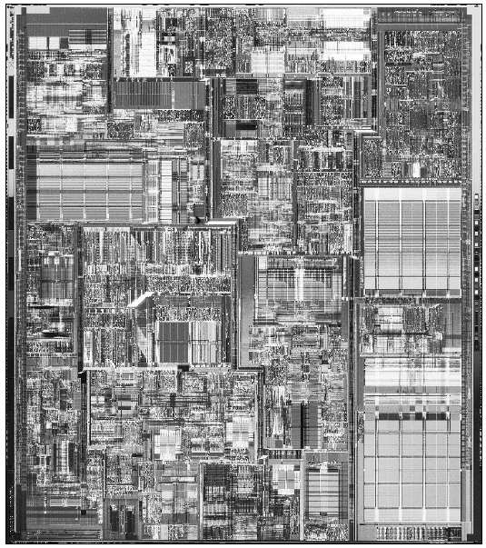
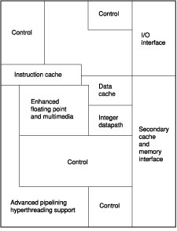
What is a Computer?
PC motherboard
Pentium processor
Inside a Pentium chip
Credit: http://www.computer-hardware-explained.com/what-is-a-motherboard.html

Slide 16
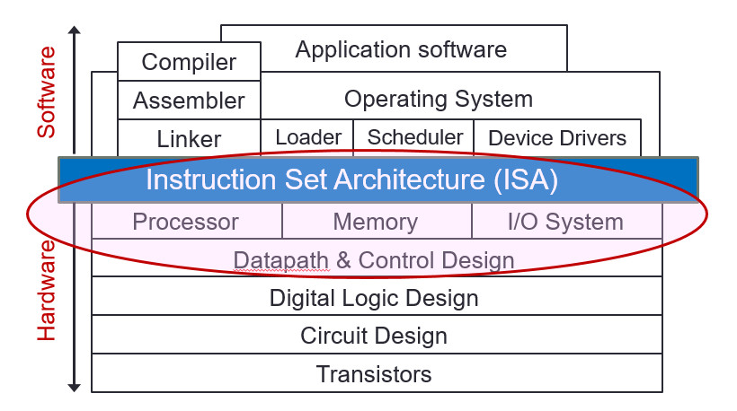
IT5002 : It’s About Computer Organization
Computer organisation is the study of internal working, structuring and implementation of a computer system.
It refers to the level of abstraction above the digital logic level, but below the operating system level.
IT5002

Slide 17
IT5002 : It’s About Computer Organization
(From user to builder)
You want to call yourself a computer scientist/specialist.
You want to build software people use.
You need to make purchasing decisions.
You need to offer “expert” advice.
Hardware and software affect performance
  Algorithm determines number of source-level statements
  Language, compiler, and architecture determine machine instructions (COD chapters 2 and 3)
  Processor and memory determine how fast instructions are executed (COD chapters 5, 6 and 7)
Understanding performance (COD chapter 4)

